Slide 1

UE19CS204 – Web Technologies Mini Project
Project Title -
Section - B
Anurita Bose – PES1UG19CS073
Anupama Nhavalore – PES1U19CS0
Vinayak C S – PES1UG19CS118
GITHUB Link - https://github.com/Web404tech/Web-Tech-Project.git

Slide 2
Abstract
We created a marketplace web application providing a smooth shopping experience for environmentally friendly and cruelty free shopping products.
This includes organic cosmetics, vegan-friendly clothing items and eco-friendly everyday essentials. Our aim is also to promote small scale businesses and brands which are supporting the same.
By providing a platform that provides only these niche range of products that are organic and environment friendly, we hope to make sustainable living the new norm.

Slide 3
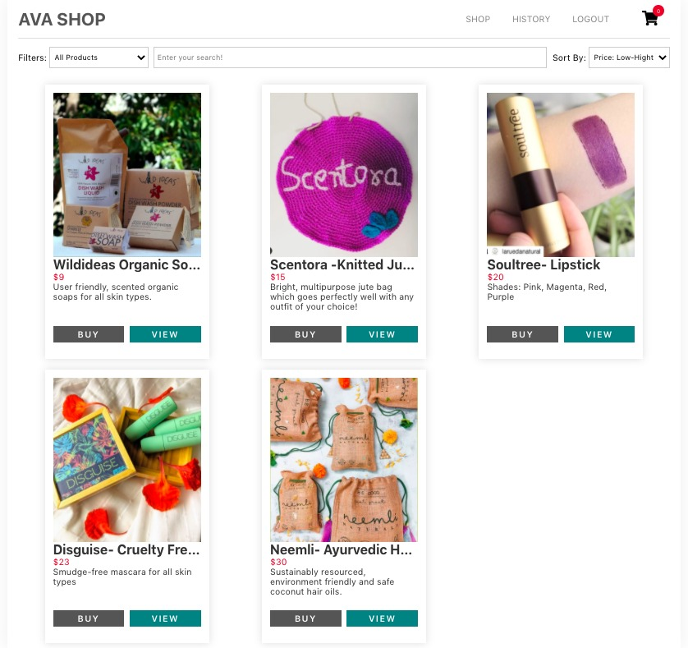
Abstract
It is essentially an ecommerce platform for environment friendly products.
We aim to promote local businesses through the same

Slide 4
Technologies Used
React
useEffect()
useState()
createContext()
react-router-dom
axios
Backend: MongoDB, Mongoose, Express.js
cloudinary
bcrypt
Paypal Express Checkout

Slide 5
Member Contributions
Vinayak C S – complete front end ( client - React.js and CSS for all components , axios, react-router-dom, global state, utils )
Anupama Nhavalore - back end ( user and category controllers and routers, mongoDB – models using mongoose)
Anurita Bose- back end ( product and payment controllers and routers, cloudinary for image upload, paypal - developer integration)

